Slide 1
HGAC Assessment

Slide 2
Methodology
I applied a methodology similar to the one shared in the Digitalization and the American Workforce model, considering our project's timeframe. Just as the section assessing digitalization uses knowledge and work activity, I evaluated analytical skills using a standardization formula from O*NET, taking into account knowledge, abilities, and skills.
"Analytical" means breaking down complex problems, identifying patterns, and making informed decisions by systematically examining information for effective problem-solving.
Choosing abilities, knowledge, and skills to assess analytical proficiency was based on the belief that effective analytical skills require more than just knowledge. I firmly believe that any job which demands a certain level of analytical ability requires a specific set of skills and abilities that promote problem-solving capabilities. However, given more time, I would have conducted further research and included additional attributes in the analysis.
The results didn't yield any major surprises, as the study was guided by specific attributes in a predetermined manner.

Slide 3
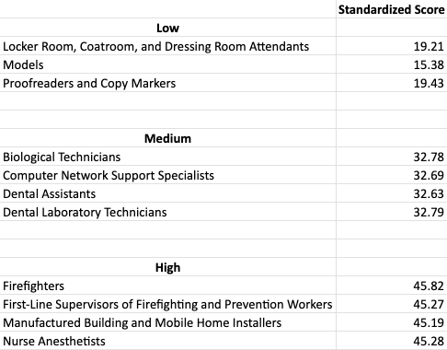
Occupation List
The listed occupations represent a subset among numerous others classified into low, medium, and high analytical scores, determined by their respective standardized scores.

Slide 4
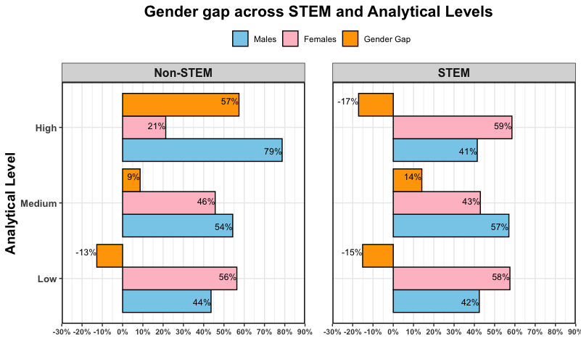
Gender Gap Analysis findings
The gender gap plot categorizes data into Low, Medium, and High analytical levels, further distinguishing between STEM (Y) and non-STEM (N) fields.
Pink bars represent the percentage of female employees, while blue bars represent males. Orange bar highlight gender gaps; a negative bar indicates female dominance, and a positive bar suggests male dominance.

Slide 5
Summary
Results:
It is evident that men are prevailing in non-STEM domains, particularly those demanding a high level of analytical skills.
However, it is apparent that the gender gap is significantly smaller in STEM fields across various levels of analytical skills. Women even surpass men in both high and low analytical skill levels.
Recommendations:
Yes, I Recommend an initiative focused in addressing the gender gap especially in Non-STEM domains with high analytical level:
Develop a targeted initiative addressing Education, recruitment, and advancement in analytical roles.
Creating opportunities for more training and networking sessions among women in non-STEM fields to enhance their abilities and competence.

